Slide 1








County Clustering for Prominent Diseases
Presentation by: Harshitha Sheshala, Maharsh Jani, Anannya Gairola, Anelda Agyei

Slide 2


Topic of Interest
Analyzing "healthiest-to-worst" county rankings through data-driven clustering approach that identifies unique profiles of community health needs, such as high-burden/low-access areas versus those with specific, localized challenges.

Slide 3

Why is this important?
1
rural areas have ⅔ of primary care physicians needed with 92% rural areas considered area with physician shortage (Stateline)
3
Understanding patterns → Improved public health policies
2
Chronic diseases predominantly in southeast regions (CDC)
4
Enables prevention

Slide 4
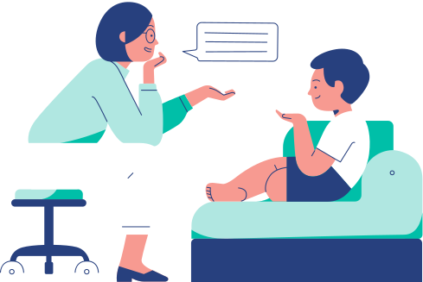
Data usage
Goal: Cluster US counties to a build a health profile to build hypothesis for best use of public health resources and predict underlying issues such as a lack of screening, physician access, economic factors etc.
Dataset: US CDC PLACES County Health Data 2024
scores all 3,145 US counties on 40 measures of disease, behavior, and access to care

Slide 5
Machine Learning Algortihms
Algorithm 1
Algorithm 2
Algorithm 3
Principle Component Analysis
To reduce dimensionality of 40+ health indicators (example; highly correlated disease rates) to ensure clustering is more stable.
K-means Clustering
To group around 3,000 counties into distinct clusters based on similarities in health outcomes, behaviors and access measures.
Hierarchical Clustering
to generate a dendrogram that helps confirm if the numbers of clusters (k) found by K-Means is natural or forced

Slide 6


Sources of Bias
Model Bias
PLACES values are estimated from a survey plus demographics, not counted, so similar-looking counties get similar numbers by default
To mitigate, we plan to use the confidence limit columns to flag shaky estimates and report them
Aggregation Bias
One county-wide average hides the rich and poor neighborhoods inside it
To mitigate, we would state that types describe counties, not individuals, and never act on a single county number alone
Sampling Bias
It’s a self-report phone survey, so it misses people without phones, non-English speakers, and undercounts stigmatized conditions
To mitigate, we would treat results as approximate and note which groups the survey underrepresents

Slide 7


AI & Ethical Impacts
Upside:
helps agencies send the right help to the right kind of place on a fixed budget.
Allocation Harm:
A "healthy" label could pull help from a county that still has a struggling neighborhood
No Ground Truth:
Advisory > Autonomous. Need to keep humans & communities in the loop

Slide 8
Mitigation Strategies
Model bias: To mitigate model bias, we plan to use the confidence limit columns to flag shaky estimates and report them.
Aggregation bias: To mitigate aggregation bias, we would state that types describe counties, not individuals, and never act on a single county number alone.
Sampling bias: To mitigate sampling bias, we would treat results as approximate and note which groups the survey underrepresents.

Slide 9


Summary
Grouping Counties
Most public-health work ranks counties from healthiest to worst. That tells you who's struggling, but not what kind of trouble they're in. We cluster instead. We group counties with similar health profiles, then match the right kind of help to each group.
Group
Map
Match

Slide 10

Sources
The Future of Medical Services
Dataset: US CDC PLACES County Health Data 2024, accessed via Kaggle (kaggle.com/datasets/aliafzal9323/us-cdc-places-county-health-data-2024).
References: Greenlund et al. (2022), PLACES: Local data for better health, Preventing Chronic Disease. Bowser et al. (2024), American clusters: using machine learning to understand health and health care disparities, Health Affairs Scholar. Khan et al. (2022), county-level risk groups and COVID-19 outcomes, BMC Public Health

